Slide 1

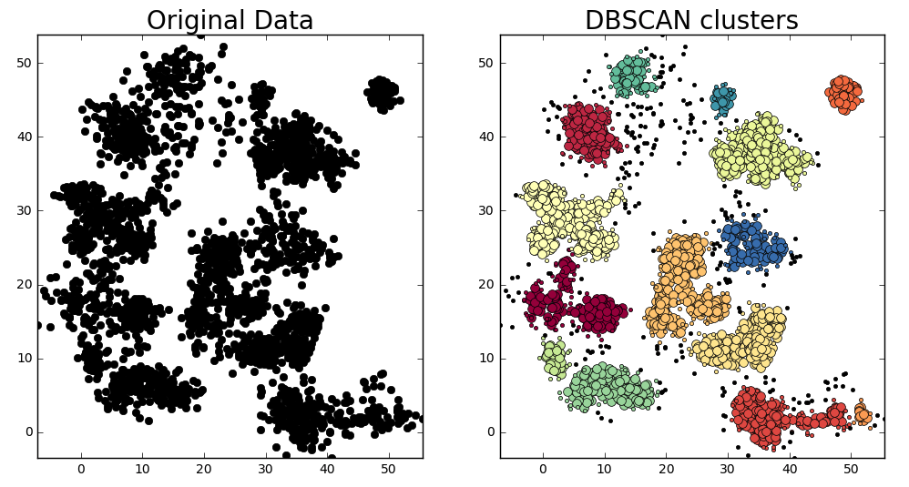
Density-Based Clustering for Geospatial Analysis: Identifying Crime Hotspots Where K-Means Fails
Reid Sendroff, Ying Li

Slide 2
Table Of contents
Table of Contents
The Problem: Crime Patterns Are Not Circular
K-Means Limitations for Geospatial Data
DBSCAN: Setup & Parameters
DBSCAN: Concept
DBSCAN: Point Classification
Dataset Overview
Spatial Cross-Validation & Metrics
Results & Comparison
Ablations & Sensitivity
Interpretability (Optional)
Live Demo
Limitations & Takeaways

Slide 3
The Problem: Crime Patterns Are Not Circular
Crime incidents form irregular, elongated clusters along streets and districts
Traditional methods assume circular, evenly sized groups
Statistical view: test Complete Spatial Randomness vs Spatial Clustering
K-Means assumes spherical clusters, poor fit for real-world geospatial data.
Real hotspots often follow street networks or community boundaries.
Crime patterns are not random, they form hotspots.
The objective : to visualize and detect true hotspots in urban areas

Slide 4
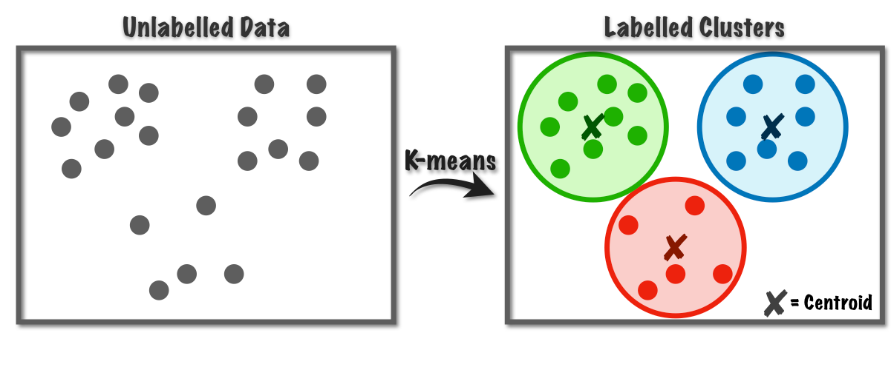
K-Means Limitations for Geospatial Data
Does not find arbitrary shapes of clusters
Sensitive to initialization and outliers.
Requires pre-specifying number of clusters (k) as a hyperparameter
Does not find arbitrary shapes of clusters
Assumes equal cluster size and density.
Cannot detect noise or non-convex cluster shapes.

Slide 5

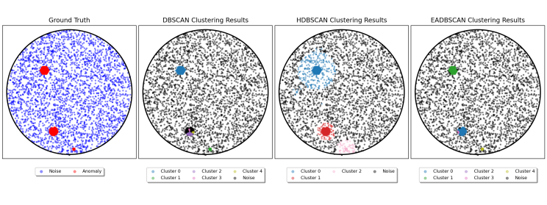
DBSCAN: Setup & Parameters
Groups closely packed points (high density) and marks sparse points as noise
Parameters:
- ε (eps): neighborhood radius
- min_samples: minimum number of points for a dense region
Finds clusters of arbitrary shape via density connectivity.
DBSCAN clusters points based on local density
Finds clusters of arbitrary shape via density connectivity
Clusters points based on local density

Slide 6

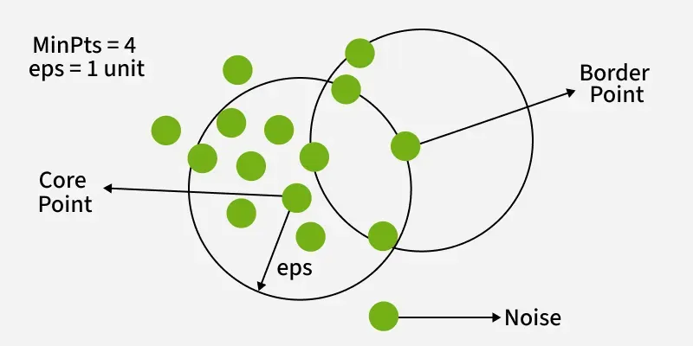
DBSCAN: Concept
Groups closely packed points (high density) and marks sparse ones as noise.
Two key parameters:
ε (epsilon): neighborhood radius
min_samples: minimum number of points in the neighborhood
A point p belongs to a cluster if it has enough neighbors within ε (epsilon).
Where:
D: The dataset of all points
q : another point within ε distance of p
If the number of points in N_eps(p) >= min_samples, p lies in a dense region
A point p belongs to a cluster if it has enough neighboring points within distance ε(eps). The neighborhood of p is defined as : N_eps(p)
DBSCAN measures how densely points are packed. A point is part of a cluster if enough neighbors exist within some small radius ε.
Unlike K-means, DBSCAN uses density rather than distance to a centroid
Critical Points
Core Point : >= min_samples inside ε
Border Point: near core, not dense enough
Noise: Isolated point

Slide 7
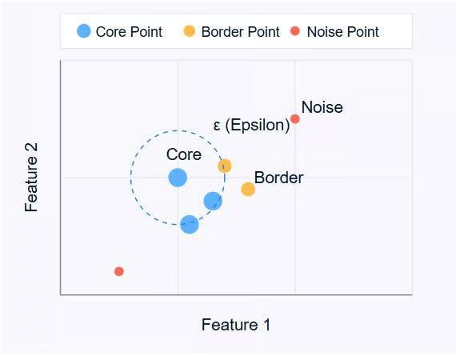
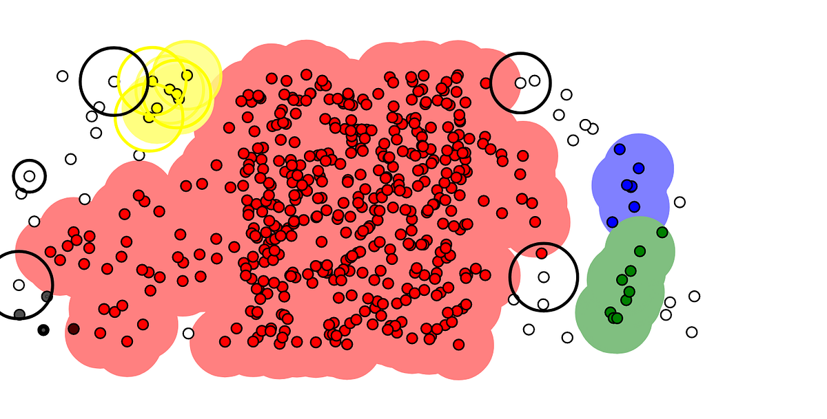
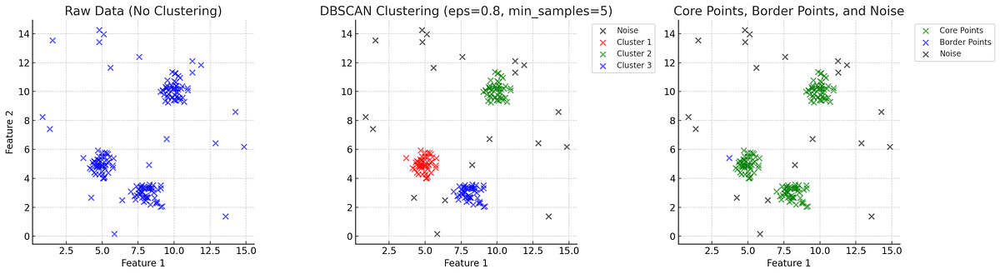

DBSCAN: Point Classification
DBSCAN Classifies each point as one of three types:
Core: ≥ min_samples within ε neighborhood
Border: Near a core point but not dense enough
Noise: Too isolated, not part of any cluster
Automatically filters isolated outliers
Supports clusters of irregular shape and density
Key:
Core points = blue
Border points = yellow
Noise = red
For each point p: find its ε-neighborhood.
You can see the non- circular clusters
Where:
D: the full set of points
q: any point in the dataset
N_eps(p) : the set of all points q in within eps distance from p
For each point p: find its ε-neighborhood.
If |N_eta(p)>=min_samples| >= min_samples, mark as core
If p is within ε of a Core but not dense itself
Otherwise, classify it as noise
If there are at least min_samples points in that neighborhood, p is in a “dense” region, therefore it is part of a cluster.

Slide 8
Dataset Overview
Example: Chicago City Crime Dataset
Features: Latitude, Longitude, Crime_Type, Time
Use real or simulated urban data.
Visualize points on map to show spatial distribution of incidents.

Slide 9
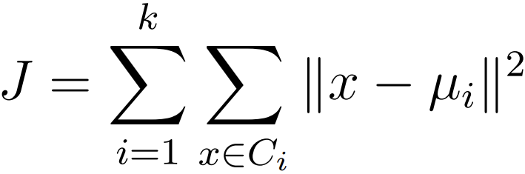
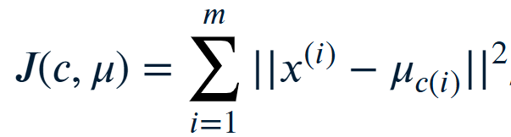
K-Means Results: The Problem Visualized
K-Means forms circular clusters that ignore real street geometry.
Some crime points are misclassified or left out of any cluster.
Hotspots get merged or split in unrealistic ways.
Hard to interpret clusters in urban layouts with irregular boundaries.
Works only when clusters are spherical and evenly distributed.
Distortion function : K-Means minimizes total within-cluster variance: assuming circular clusters.
J is the sum of distances in its cluster squared from the cluster’s centroid. Total squared error from

Slide 10
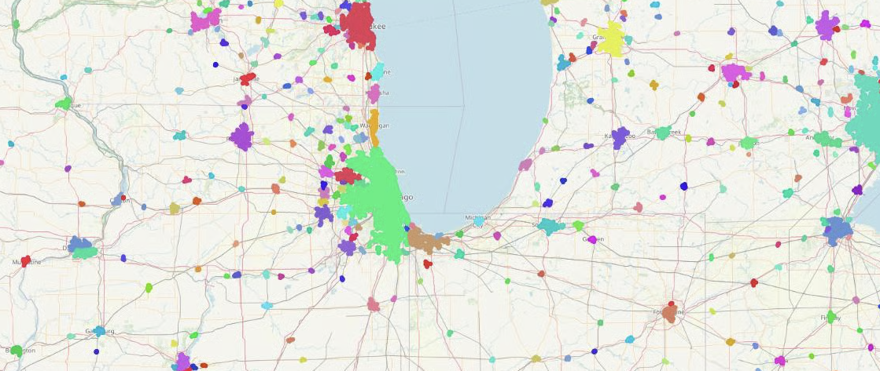

DBSCAN Results: Finding True Hotspots
DBSCAN identifies true crime hotspots following street layouts
K doesn’t need to be predefined, clusters will be identified based on density.
Automatically filters noise, removes isolated sections
Identifies meaningful clusters while filtering noise.
Detects irregular shapes, not necessarily circular
Provides interpretable clusters aligned with real geography
DBSCAN vs k means in urban setting Graph
DBSCAN groups all points within ε(eps) distance and sufficient density into clusters, not just radius-based.
We include a point p in a cluster if it is a subset of D (valid density array) or if its distance is at most ε(eps).

Slide 11
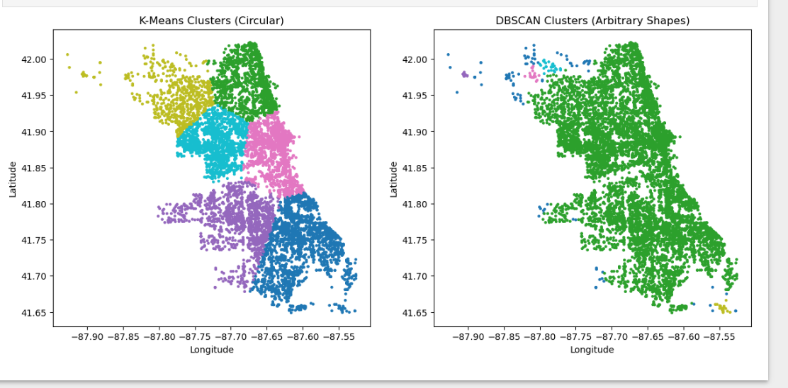
Side-by-Side K-Means vs DBSCAN Comparison
K-Means: 6 clusters, silhouette = 0.407
DBSCAN : 5 clusters (+ noise), silhouette = 0.065
Need k | Yes | No
Handles noise | No | Yes
Handles variable density | Poorly | Moderate
Runtime | Fast | Moderate

Slide 12
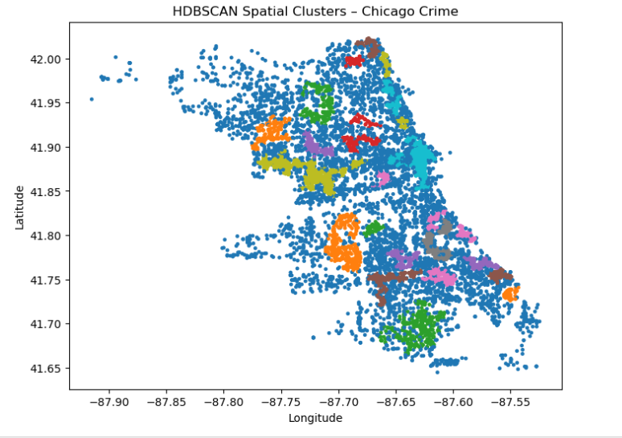
HDBSCAN: Handling Variable Density
import hdbscan
X = sample_df[['latitude','longitude']].values
clusterer = hdbscan.HDBSCAN(min_cluster_size=50, min_samples=10)
sample_df['hdbscan'] = clusterer.fit_predict(X)
plt.figure(figsize=(8,6))
plt.scatter(sample_df['longitude'], sample_df['latitude'], c=sample_df['hdbscan'], s=6, cmap='tab10')
plt.title("HDBSCAN Spatial Clusters – Chicago Crime")
plt.xlabel("Longitude"); plt.ylabel("Latitude")
plt.show()

Slide 13
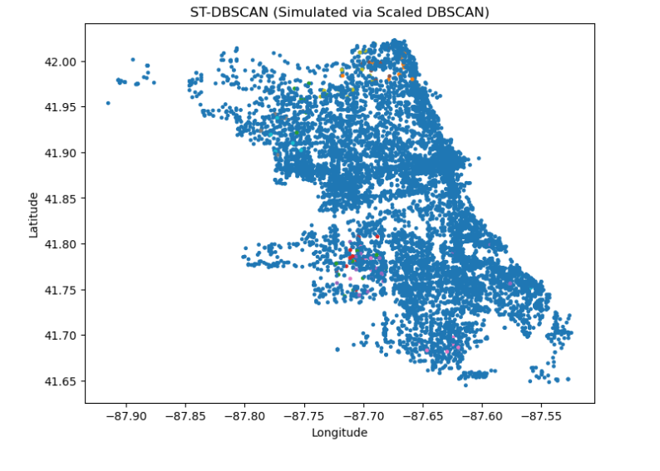
ST-DBSCAN (Add Time Dimension)
from sklearn.cluster import DBSCAN
import numpy as np
import matplotlib.pyplot as plt
# prepare data
sample_df['timestamp'] = sample_df['date'].astype('int64') // 10**9
# Scale time so spatial and temporal distances are comparable
# (1 degree ≈ 111 km; convert time window ≈ 3 days)
space = sample_df[['latitude', 'longitude']].to_numpy()
time = sample_df[['timestamp']].to_numpy()
# Normalize
space_scaled = (space - space.mean(axis=0)) / space.std(axis=0)
time_scaled = (time - time.mean()) / (60*60*24*3) # 3 days ≈ 1 temporal unit
# Combine spatial + temporal features
coords_time = np.hstack([space_scaled, time_scaled])
# run DBSCAN
stdbscan = DBSCAN(eps=0.5, min_samples=10).fit(coords_time)
sample_df['stdbscan'] = stdbscan.labels_
# visualize
plt.figure(figsize=(8,6))
plt.scatter(sample_df['longitude'], sample_df['latitude'],
c=sample_df['stdbscan'], cmap='tab10', s=6)
plt.title("ST-DBSCAN (Simulated via Scaled DBSCAN)")
plt.xlabel("Longitude"); plt.ylabel("Latitude")
plt.show()

Slide 14
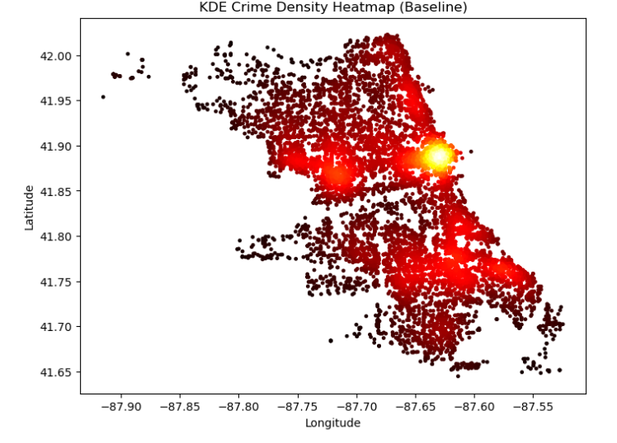
KDE (Baseline Density Estimation)
from sklearn.neighbors import KernelDensity
coords = sample_df[['latitude','longitude']].to_numpy()
kde = KernelDensity(bandwidth=0.01, kernel='gaussian').fit(coords)
densities = np.exp(kde.score_samples(coords))
sample_df['kde_density'] = densities
plt.figure(figsize=(8,6))
plt.scatter(sample_df['longitude'], sample_df['latitude'], c=densities, cmap='hot', s=6)
plt.title("KDE Crime Density Heatmap (Baseline)")
plt.xlabel("Longitude"); plt.ylabel("Latitude")
plt.show()

Slide 15
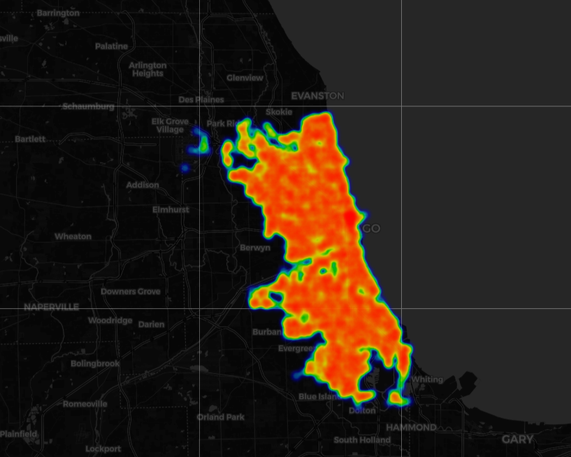
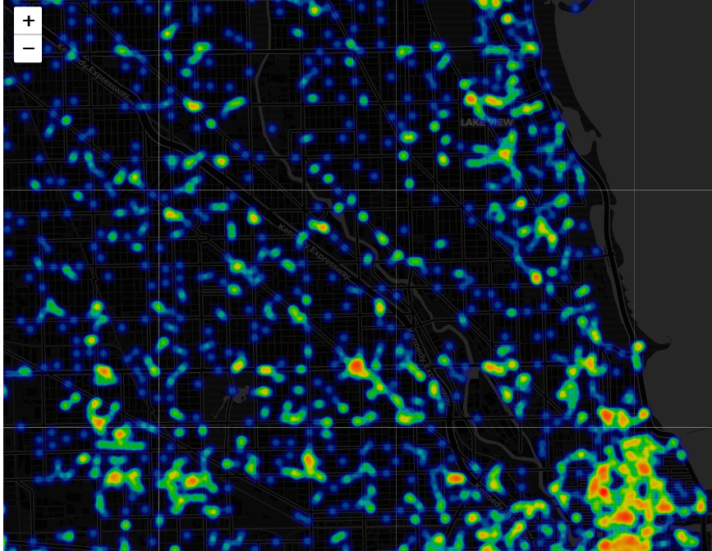
Model Evaluation & Interactive Hotspot Map
Validation window: Sept 11 – Oct 11, 2025
Validation records: 19,762 crimes
PAI@5% = 16.23% → about 16% of future crimes occurred within the top 5% predicted high-risk zones
Shows the model can successfully highlight key hotspot areas for proactive policing

Slide 16
Conclusion
• K-Means oversimplifies geospatial crime patterns.
• DBSCAN and HDBSCAN reveal real-world hotspot structures.
• Ideal for city planners, safety agencies, and data-driven policing.
• Future Work: Integrate time-series and predictive crime risk mapping.

